Slide 1

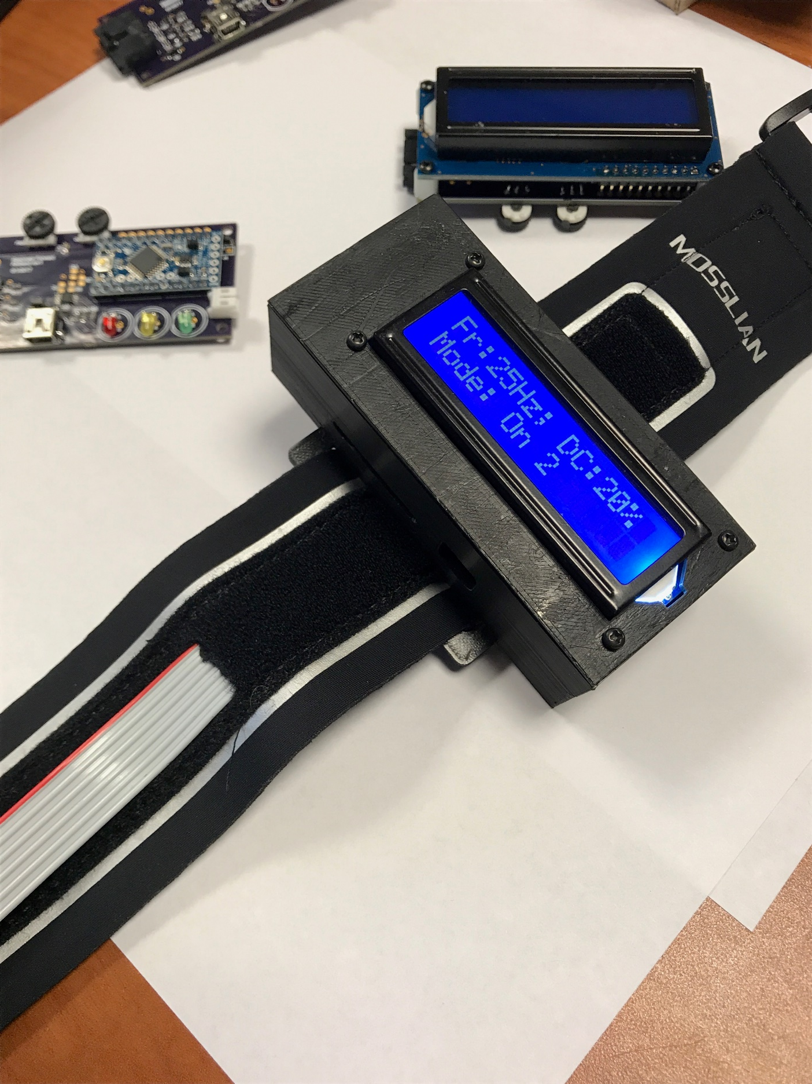

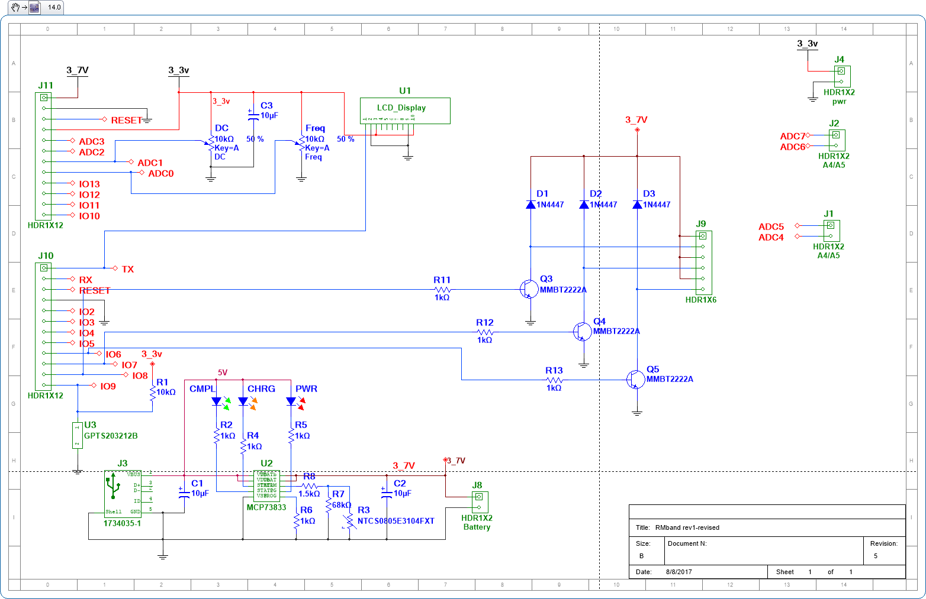
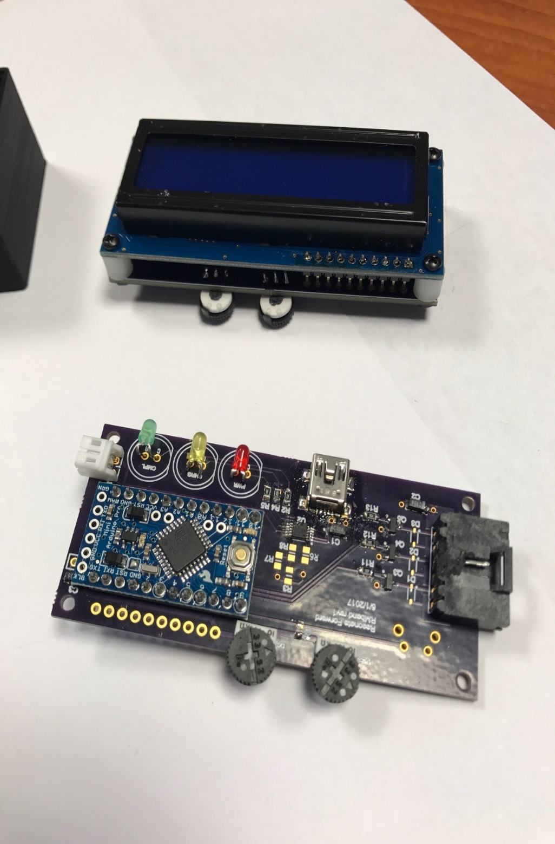
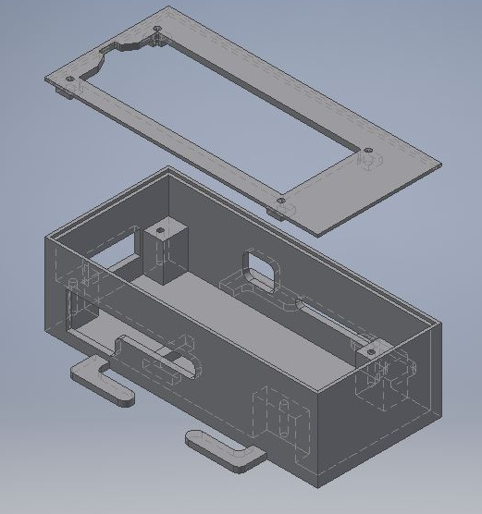
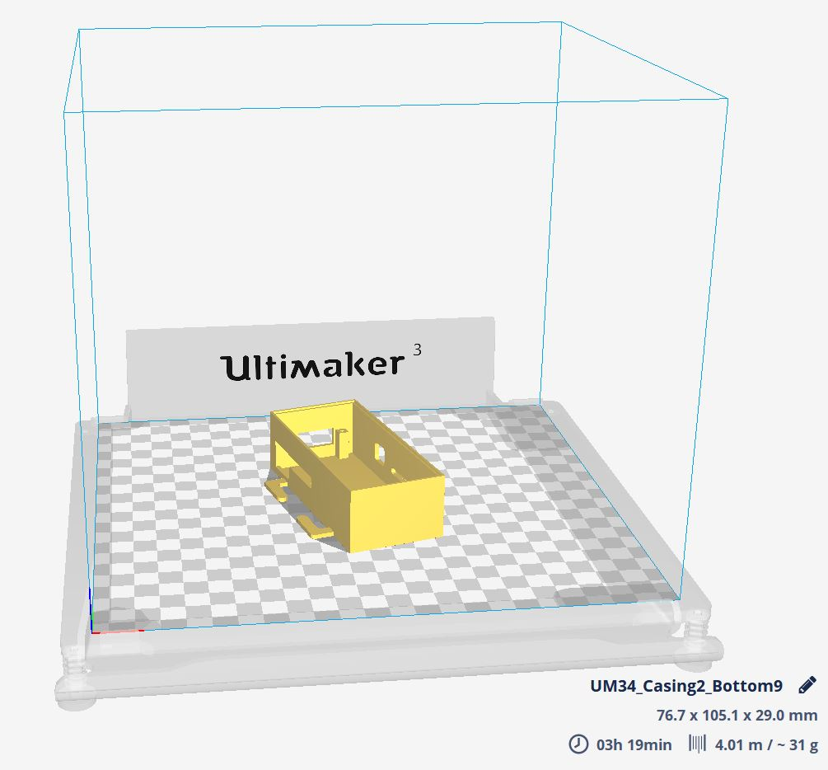
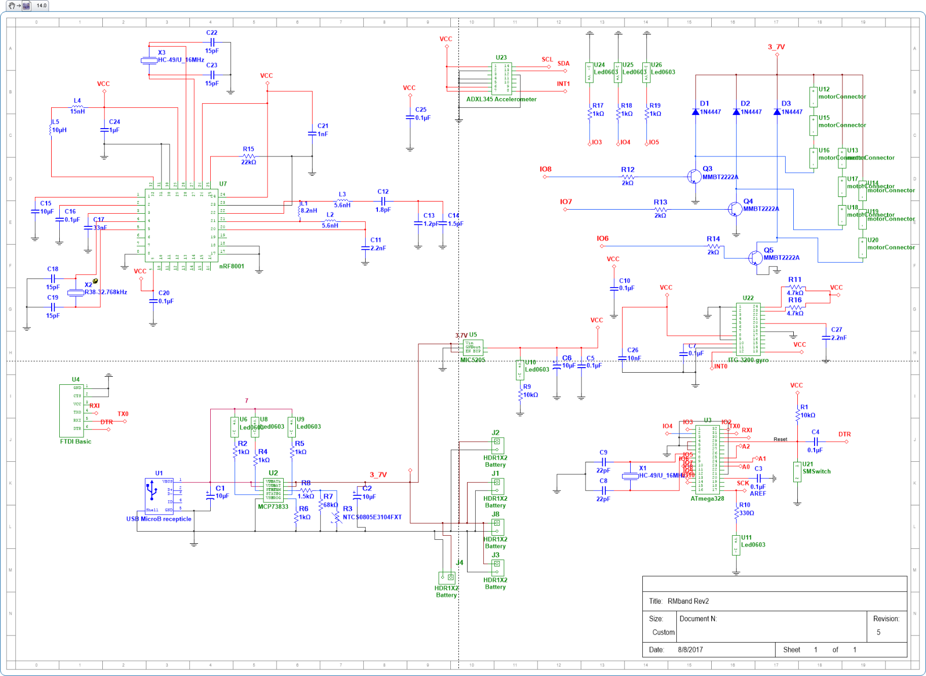

Armband Designed to Mitigate the effects of Tremors caused by Parkinson’s Disease
Paul G. Jureidini, Joshua Weinick, Dr. Richard Martin, and Dr. Mark Mirotznik
Electrical and Computer Engineering. University of Delaware. Newark, Delaware
Outstanding Problem:
The currently incurable disease, known as Parkinson’s Disease, effects over 10 million people around the world, with approximately sixty thousand being diagnosed with the disease each year in the United States alone. There are many ways to cope with the disease, however these methods are hardly a viable solution. Some of the most common ways to deal with the disease are either through invasive surgery or through various prescription drugs. Both of these methods will almost always have some type of negative side effect leaving many patients choosing to endure the hardships of Parkinson’s Disease for fear of these negative side effects.
Circuit Design:
We used a microchip (MCP73833) to manage the charging of the Lithium-Ion batteries. We also included 3 different colored LEDs to indicate charge level of the device.
Two potentiometers and one button are used to control the settings for the device. The potentiometers control the frequency and duty cycle of the motors, and the button rotates through the 5 different modes.
OFF – No motors are turned on
ON 1 -> ON 3 – Corresponds to each set of motors (ex. ON 1 means only the first set of motors are turned on)
ALL ON – All 3 sets of motors are turned on
Using 3 General-Purpose NPN transistors, we are able to use the Arduino’s I/O pins to control each set of motors individually.
Testing the Solution:
After this design was complete we went forward and tested the device on a patient with Parkinson’s Disease. The device seemed to mitigate the tremors in the patients arm. Showing that the device had potential to help out patients with Parkinson’s gave us hope to move forward with our next design.
Top View
2
3
Parkinson’s Disease effects 1/100 people in the US over 60 years of age
1
Bottom View
Project Status:
The Current goal of the project is to make the device completely contained within the wearable band. We are also looking to include new features such as Bluetooth capability, and the ability for the device to collect data about how the patient moves and performs every day activity. To add these additional features, we must add our own Bluetooth module, accelerometer, and gyroscope.
While in addition to expanding the functionality of our device, we also hope that this will enable us to be able to use this device for many other applications.
3D Printed Model:
Using Autodesk Inventor Pro, we designed an enclosure for our Printed Circuit Board, LCD display and lithium ion battery. Then using a slicing program such as Cura, we were able to convert it to a Gcode file to send to a 3D printer.
Approach:
One of the most commons symptoms of Parkinson’s Disease is uncontrollable shaking, which makes it nearly impossible to carry out everyday tasks such as writing on a notepad or typing on a computer. Our solution to this problem is to mitigate these symptoms so that the patient will be able to carry out their everyday tasks without having these uncontrollable tremors. The idea is to create an armband that will wrap around the patients tremoring arm. Each armband is equipped with several vibrating motors that can be adjusted by frequency as well as duty cycle. When these motors are operated accordingly, the small vibrations that they generate send mixed signals to the brain. These signals confuse the brain into thinking their muscles are already vibrating, therefore calming the muscle movements of the patient.

